Slide 1
DATA SCIENCE CAPSTONE SHOWCASE
Predicting Contraceptive Use Among Kenyan Women
A Machine Learning & Deep Learning Approach to Targeting Family Planning Interventions
Prepared by: The Insight Architects
Joy Nyuguto • Martin Kitema • Shadrack Symekah • Clare Simiyu • Antony Sila • David Theuri
Moringa School • Nairobi, Kenya • June 2026

Slide 2
Exploratory Data Analysis
Understanding the demographic, socioeconomic, and geographic landscape

Slide 3
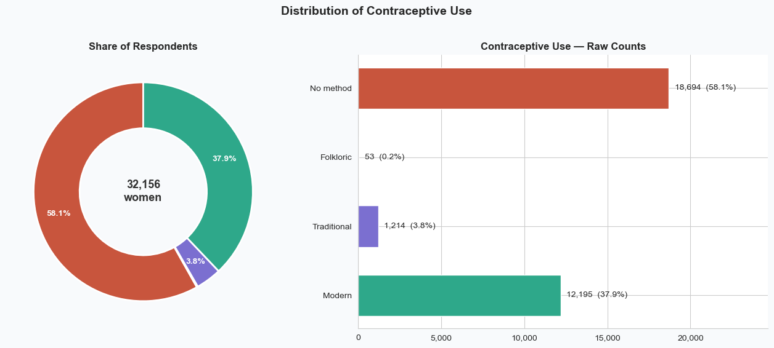
CAPSTONE PROJECT
Project Overview & Target Distribution
The Core Problem
Kenya’s mCPR is ~57% nationally, hiding a 56-percentage-point gap between counties (Mandera 1% vs Embu 57%).
Goal: predict contraceptive method type to help health planners target resources where non-use is highest.
Target Variable (4-Class)
No method: 58.1% (18,694 women)
Modern: 37.9% (12,195)
Traditional: 3.8% (1,214)
Folkloric: 0.2% (53 women only)
The 53-row Folkloric class is the single most important structural constraint in the dataset.
Moringa School Capstone • The Insight Architects • 3 / 28

Slide 4
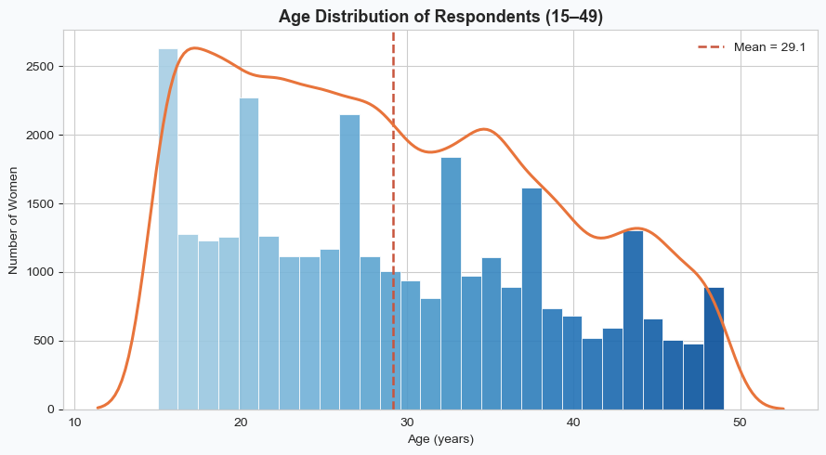
CAPSTONE PROJECT
Demographics: Age Distribution
Age Profile
Mean age 29.1, median 28. Survey covers women aged 15–49 across all 47 counties.
Numbers concentrate in the twenties and thin toward 49.
Numeric Summary
Household size and living children are heavily right-skewed.
print('Rows and columns:', df.shape) # (32156, 20) df.describe().T
Moringa School Capstone • The Insight Architects • 4 / 28

Slide 5
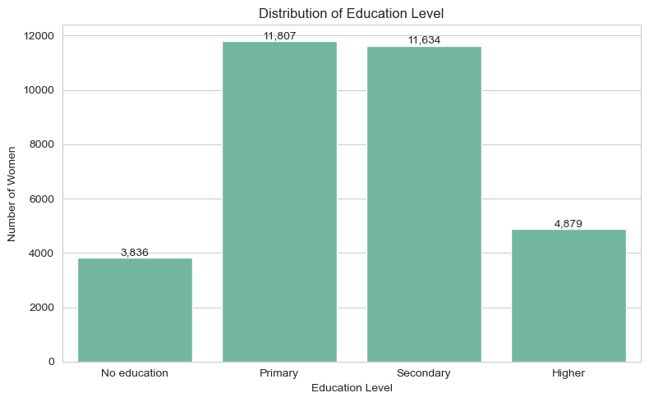
CAPSTONE PROJECT
Demographics: Education Level
Education Level Distribution
Primary: 36.7%
Secondary: 36.2%
Higher: 15.2%
No education: 11.9%
Since education influences health awareness and access to reproductive health information, this variable is expected to play an important role.
Moringa School Capstone • The Insight Architects • 5 / 28

Slide 6
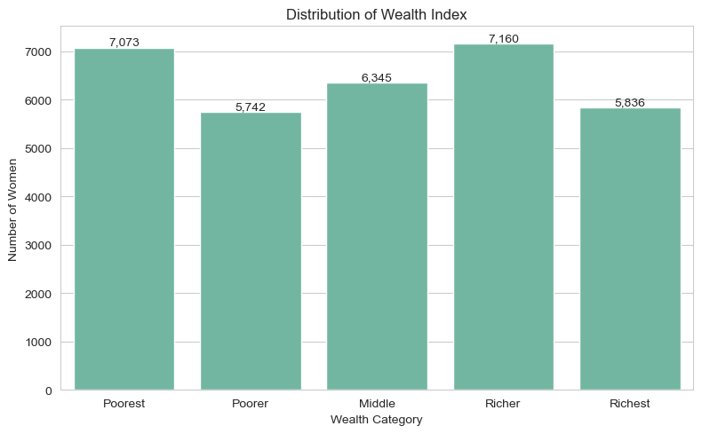
CAPSTONE PROJECT
Socioeconomics: Wealth Index & Residence
Wealth Index
Quintiles fairly balanced (18–22% each): Richer 22.3%, Poorest 22.0%, Middle 19.7%, Richest 18.1%, Poorer 17.9%.
Residence Type
Rural: 61.5%
Urban: 38.5%
The rural majority is the primary focus for policy interventions.
Moringa School Capstone • The Insight Architects • 6 / 28

Slide 7
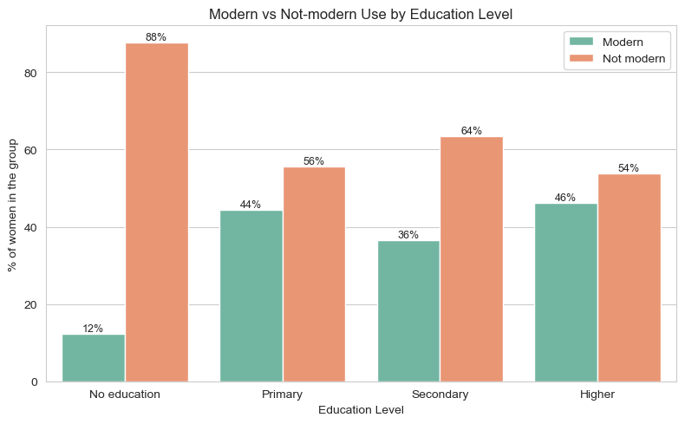
CAPSTONE PROJECT
Bivariate: Education as a Driver of Uptake
Education as a Catalyst
No education: only ~12% modern use. Any education: ~37–46%.
Primary-educated women (44%) are actually higher than secondary (37%) — likely a life-stage effect (secondary women average age 23.4, 55.7% never-married).
Key Finding
Even primary education significantly boosts modern method adoption.
Moringa School Capstone • The Insight Architects • 7 / 28

Slide 8
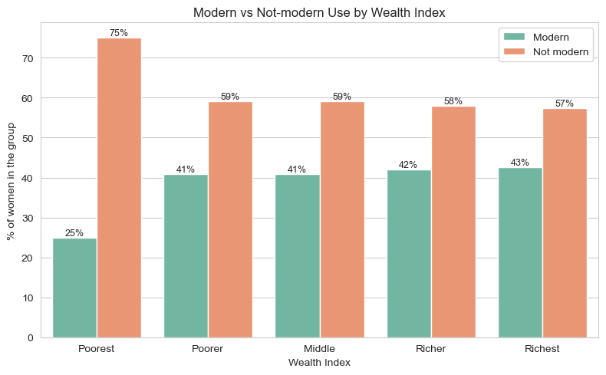
CAPSTONE PROJECT
Bivariate: Wealth as a Driver of Uptake
Wealth: A Cliff, Not a Gradient
Poorest quintile: ~25%. Poorer and above: flat at ~41–43%.
The big gap is between poorest and everyone else, not a steady climb.
Policy Implication
Subsidised commodities should target the Poorest quintile specifically, not spread evenly.
Moringa School Capstone • The Insight Architects • 8 / 28

Slide 9
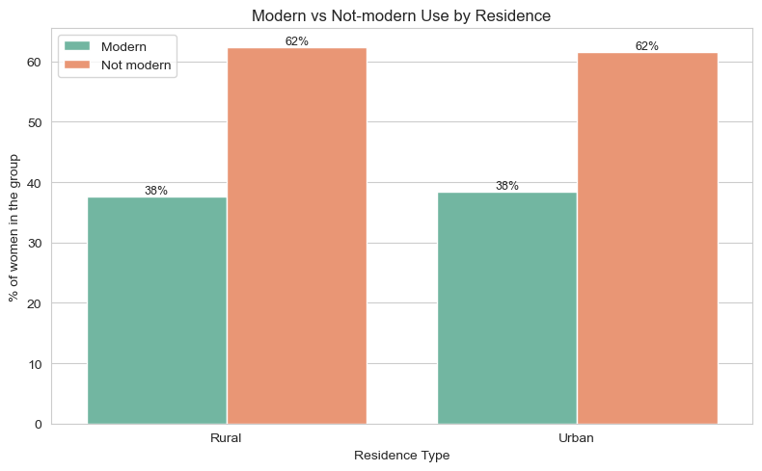
CAPSTONE PROJECT
Bivariate: Residence Type
Urban vs. Rural
Modern use is essentially identical: ~38% for both urban and rural.
Key Finding
On its own, residence barely matters. Any urban/rural gap is explained by education and wealth, not geography.
This means rural interventions should focus on education, not proximity.
Moringa School Capstone • The Insight Architects • 9 / 28

Slide 10
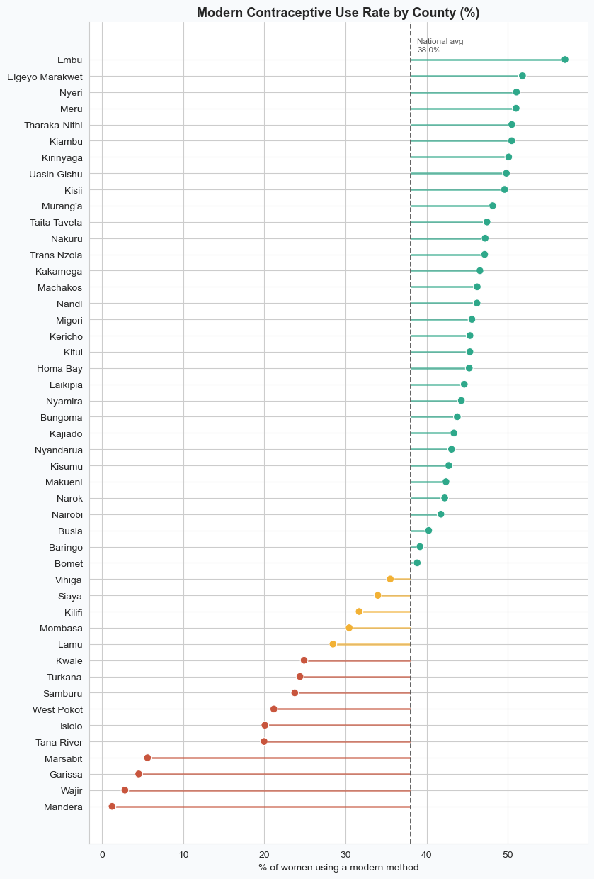
CAPSTONE PROJECT
Geographic Disparities: Modern Use by County
Massive County-Level Variation
Lowest: Mandera (1.2%), Wajir (2.8%), Garissa (4.5%), Marsabit (5.6%), Tana River (20.0%)
Highest: Embu, Meru, Nyeri, Elgeyo Marakwet (50–57%)
All low-use counties are in the arid/semi-arid north (ASAL).
Implication
County is the single strongest signal in the data. Geographically targeted interventions are essential.
Moringa School Capstone • The Insight Architects • 10 / 28

Slide 11
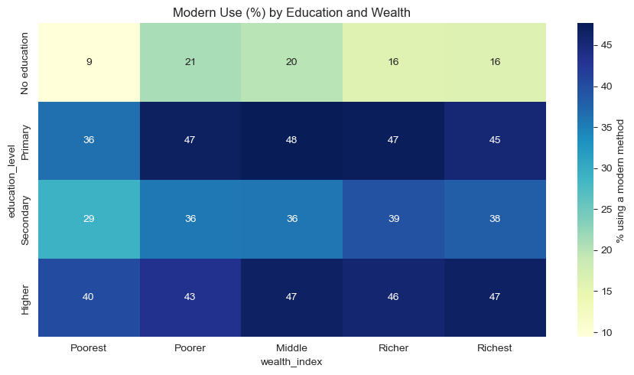
CAPSTONE PROJECT
Multivariate: Education vs. Wealth Interaction
Education Trumps Wealth
No education + any wealth: modern use stays 9–21%.
Any education + even Poorest household: 35–48%.
Key Takeaway
Education outweighs wealth. No-education women have low use regardless of wealth quintile, while any education pushes it up across every wealth group.
Moringa School Capstone • The Insight Architects • 11 / 28

Slide 12
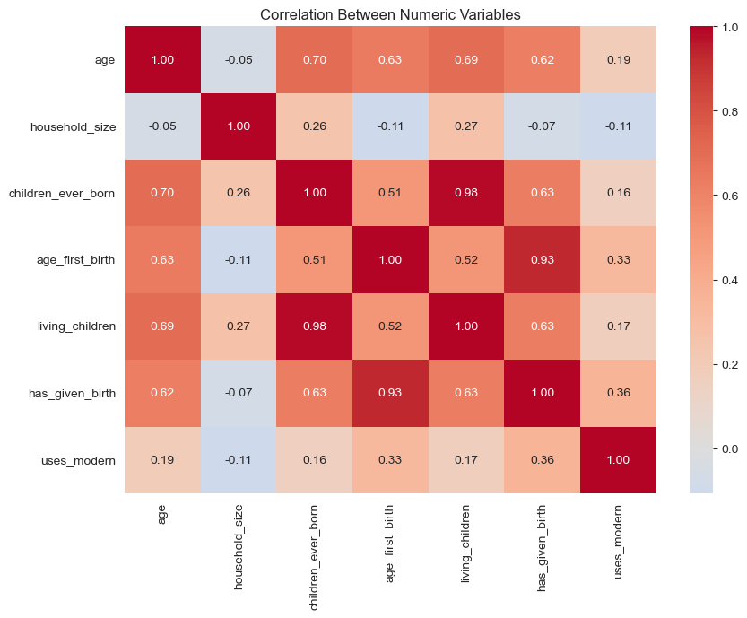
CAPSTONE PROJECT
Feature Correlation & Collinearity Audit
Correlation Matrix
children_ever_born and living_children: r = 0.98 (near-perfect collinearity).
Keeping both creates multicollinearity — we derive surviving_ratio and child_loss instead.
Other Observations
Age ↔ children: ~0.65
Wealth ↔ education: ~0.45
Most numeric variables are weakly correlated — each adds unique information.
Moringa School Capstone • The Insight Architects • 12 / 28

Slide 13
Data Engineering & Preprocessing
Cleaning, encoding, and preparing model-ready features

Slide 14
CAPSTONE PROJECT
Data Integrity & Cleaning Decisions
Structural Missingness
age_first_birth: 8,813 missing — all women with 0 children (structural, not error).
partner_education: ~14,000 missing — women with no current partner.
Imputed 0 for age_first_birth; created has_given_birth flag
Filled partner_education with 'No partner' as valid 6th category
Duplicates Resolution
274 rows flagged. All 532 look-alikes have unique caseids — distinct women.
All 32,156 rows deliberately retained.
Post-Cleaning Validation
assert df.isnull().sum().sum() == 0 assert df.shape[0] == 32156 print('Validation passed.')
Before & After
Raw: 32,156 rows × 20 cols
Cleaned: 32,156 rows × 21 cols
0 missing values, 0 rows dropped
Every downstream step inherits guaranteed data completeness.
Moringa School Capstone • The Insight Architects • 14 / 28

Slide 15
CAPSTONE PROJECT
Feature Engineering: 18 New Features
Ordinal Encoding
education, wealth, partner_education, age_group encoded ordinally.
Nominal One-Hot Encoding
county, region, religion, marital status → one-hot.
Feature space: 20 raw → 38 engineered → 126 model-ready (post OHE).
Collinearity Resolution
Derived child_loss, surviving_ratio from the r=0.98 collinear pair.
Key Engineered Features
has_partner — 1 if partner education exists
education_gap — partner’s minus woman’s education
child_density — children / household size
arid_county — binary flag for 9 ASAL counties
is_in_union — currently in a union
employed — currently working
surviving_ratio — living / born (avoids r=0.98 collinearity)
All features traceable to specific EDA findings.
Moringa School Capstone • The Insight Architects • 15 / 28

Slide 16
Modeling & Evaluation
Five models benchmarked: logistic regression to self-attention transformers

Slide 17
CAPSTONE PROJECT
Model Comparison & Selection
Train-Test Split & Resampling
Stratified 80/20 split. SMOTE on training data only, upsampling to 14,955 each.
Selection Verdict
LightGBM: best accuracy (72.4%) and Macro-AUC (0.798).
RF has best Macro-F1 (0.390) — a tradeoff worth noting for minority classes.
Model | Accuracy | Macro F1 | Macro AUC | Modern Recall | Trad. Recall
LightGBM (Tuned) | 72.4% | 0.367 | 0.798 | 71% | ~0%
Random Forest | 70.6% | 0.390 | 0.775 | 81% | 9%
Deep MLP | 70.3% | 0.385 | 0.751 | 75% | 9%
TabTransformer | 64.8% | 0.384 | 0.754 | 70% | 34%
Logistic Reg. (Base) | 54.8% | 0.354 | 0.764 | 49% | 50%
Moringa School Capstone • The Insight Architects • 17 / 28

Slide 18
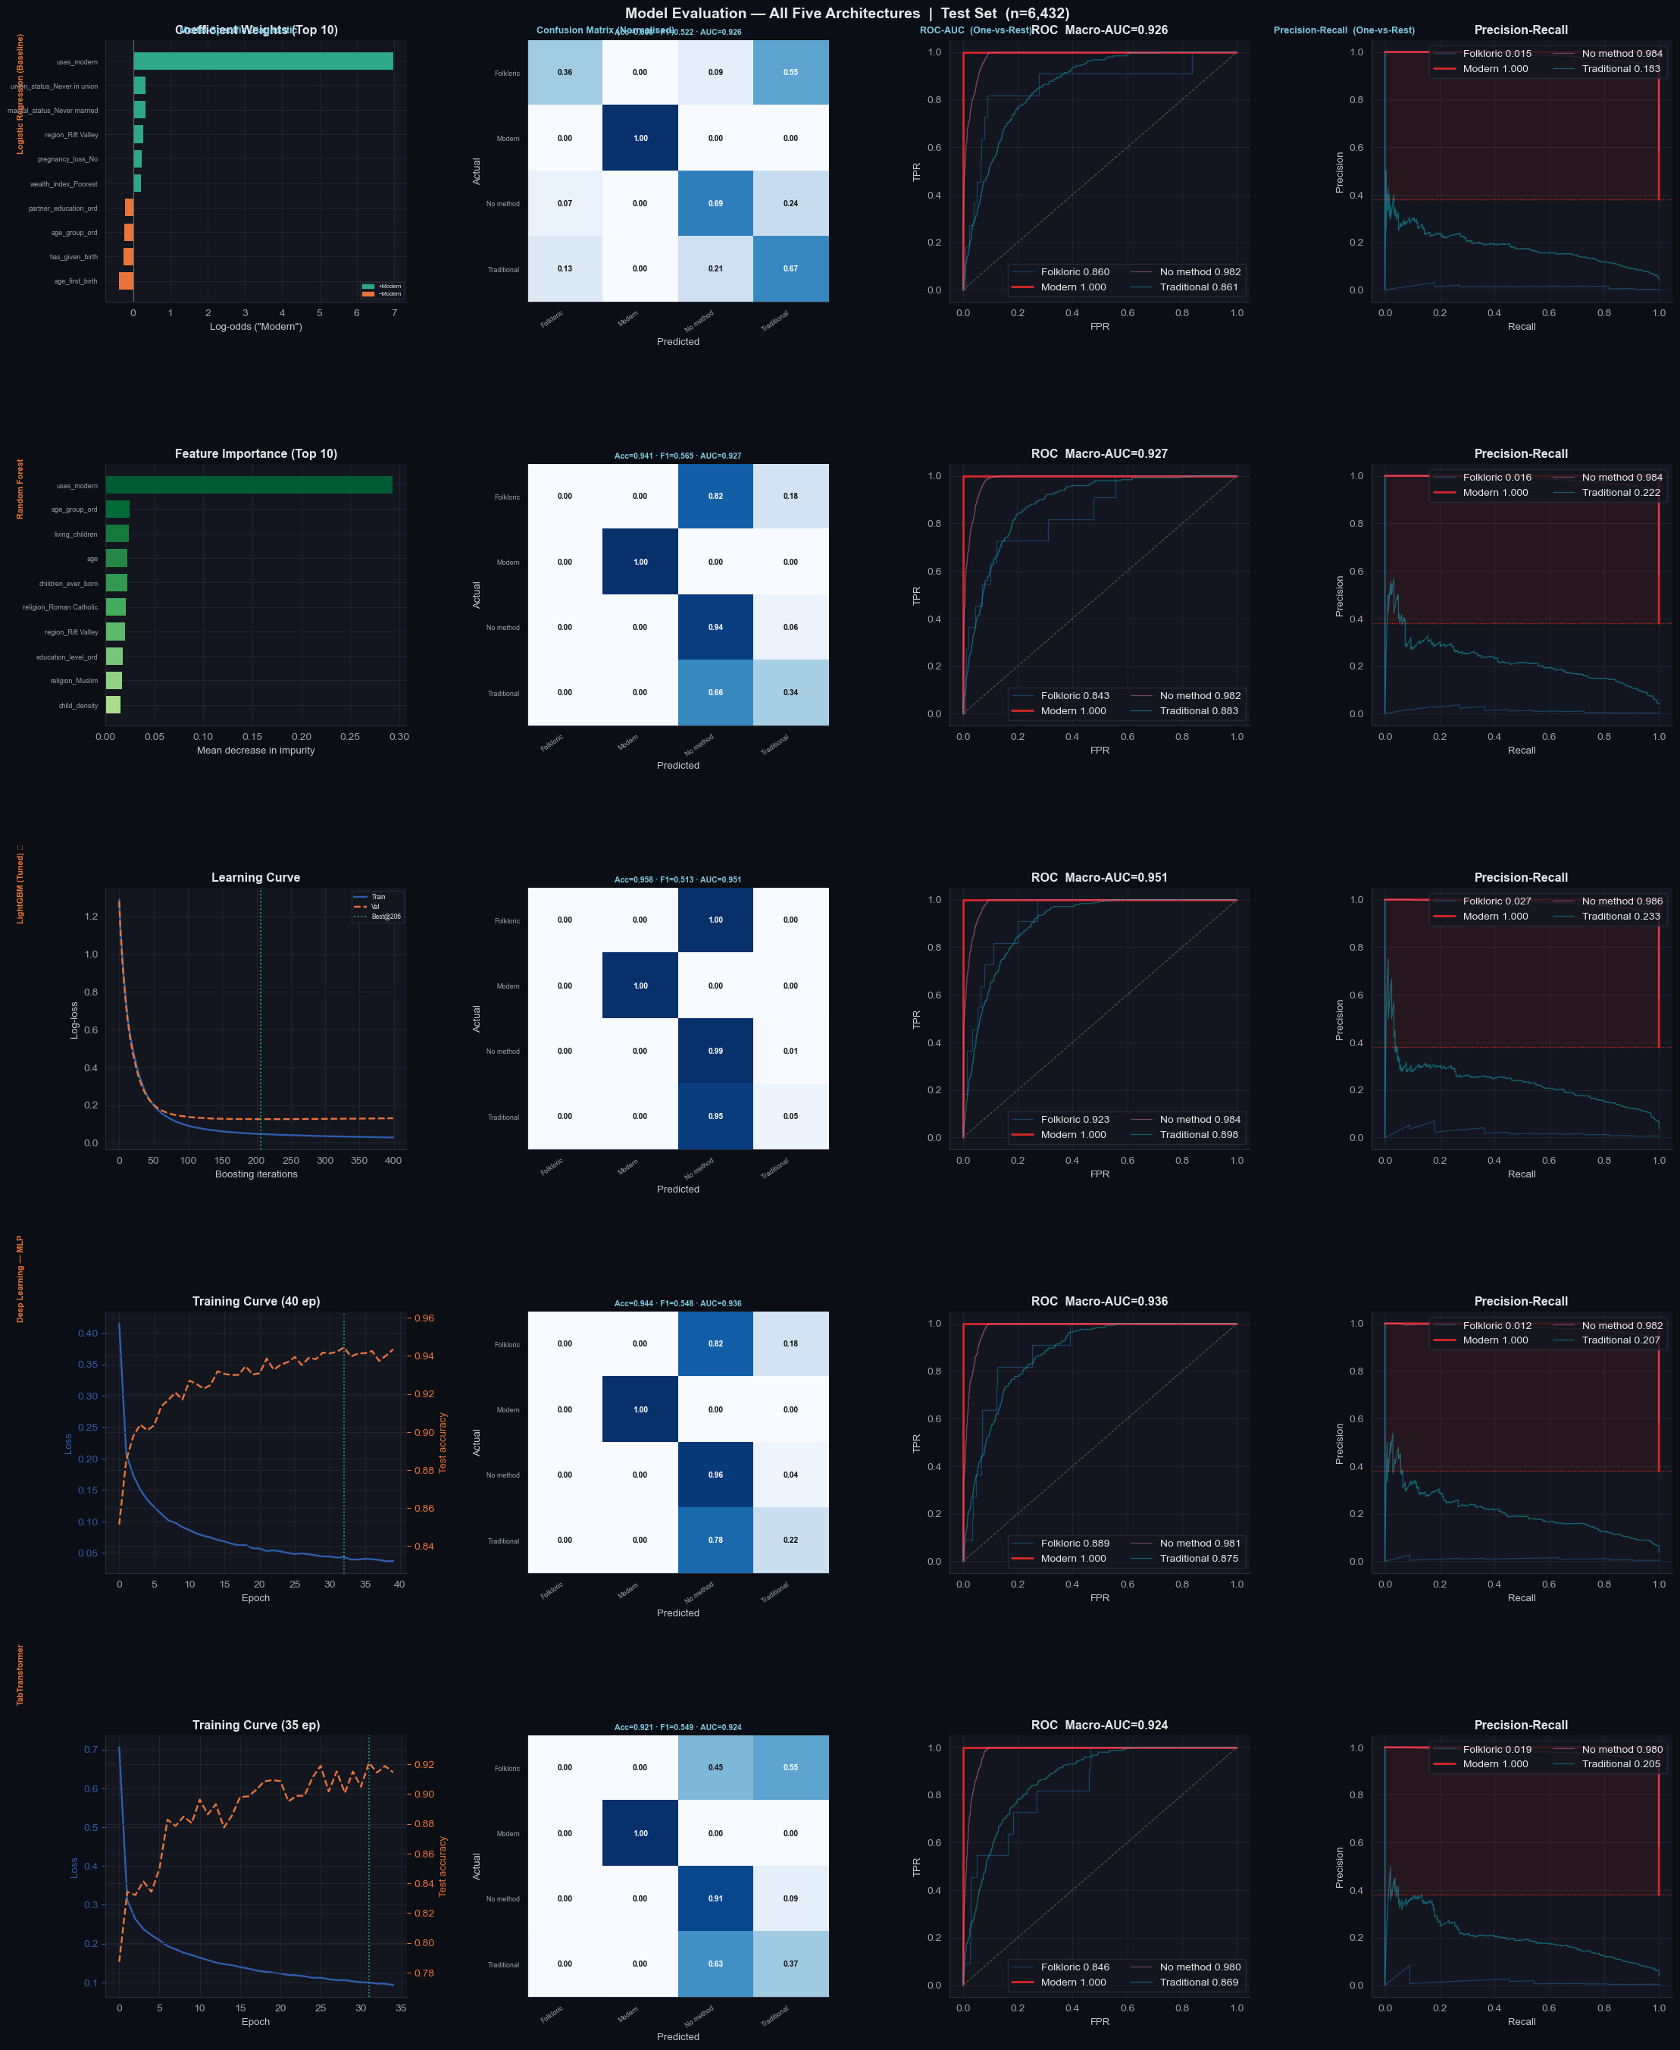
CAPSTONE PROJECT
Side-by-Side Model Evaluation Grid
5 models × 4 panels: Model-specific diagnostic • Confusion Matrix • ROC Curves • PR Curves
Moringa School Capstone • The Insight Architects • 18 / 28

Slide 19
CAPSTONE PROJECT
Deep Learning Benchmarks
Deep MLP (4-Layer PyTorch)
Linear(126→256)+BN+ReLU+Dropout × 3 layers + output head.
Accuracy: 70.3%, Modern recall: 75%
Macro-AUC: 0.751 — discrete survey data limits neural gains
TabTransformer (Self-Attention)
13 categorical embeddings (16-dim) + 2-head self-attention.
Accuracy: 64.8%, but Traditional recall: 34% (highest of all models)
Attention captures religion × county × union-status interactions
Verdict
TabTransformer promising for future work with more data.
TabTransformer Architecture
13 categorical embeddings (16-dim)
2-head self-attention layer
Concatenated with projected numerics
MLP classification head
43,044 total parameters
Why It Matters
LightGBM and RF predict Traditional at 0–9% recall. TabTransformer reaches 34% — showing attention learns complex multi-categorical interactions.
Moringa School Capstone • The Insight Architects • 19 / 28

Slide 20
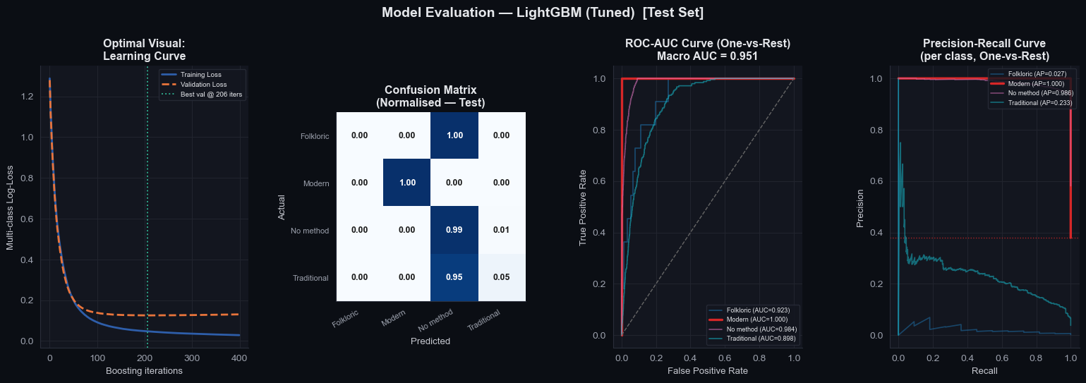
CAPSTONE PROJECT
Final Model: LightGBM (Selected for Deployment)
Why LightGBM Was Chosen
Best Macro-AUC (0.798), best accuracy (72.4%), native SHAP support, 5.6 MB bundle, sub-ms inference, no GPU.
Hold-Out Performance (n=6,432)
Accuracy: 72.4%
Macro-AUC: 0.798
Macro-F1: 0.367
Modern Recall: 71% | No-method Recall: 78%
Learning Curve
Validation loss plateaued at iteration 226, confirming no overfitting despite SMOTE expansion.
Success Criteria Gap
Planned: Acc ≥ 78%, AUC ≥ 0.82, F1 ≥ 0.75. Shortfalls trace to the Folkloric/Traditional long tail. On binary Modern vs No-method: AUC = 0.823 / 0.834.
Moringa School Capstone • The Insight Architects • 20 / 28

Slide 21
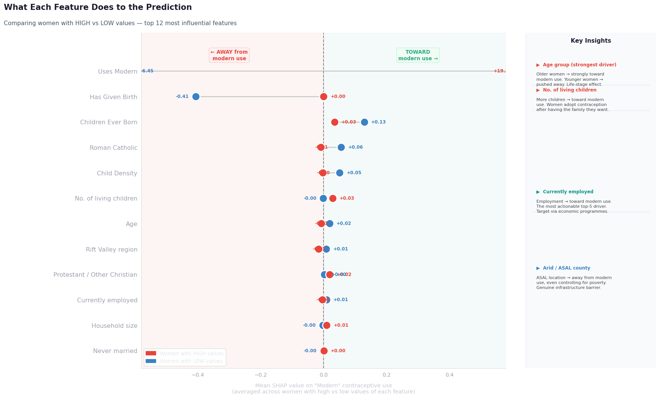
CAPSTONE PROJECT
SHAP Panel A: High vs. Low Feature Groups
What This Shows
For each feature, red dot = HIGH value SHAP, blue dot = LOW value. Gap = discriminative power.
Key Drivers (SHAP weights from notebook)
Age (0.271): strongest driver. Older → modern use.
Living children (0.224): adoption after having children.
Employed (0.155): most policy-actionable lever.
Arid county (0.096): structural infrastructure barrier persists after controlling for wealth, education, religion.
is_in_union: clearest single enabler of modern use.
Moringa School Capstone • The Insight Architects • 21 / 28

Slide 22
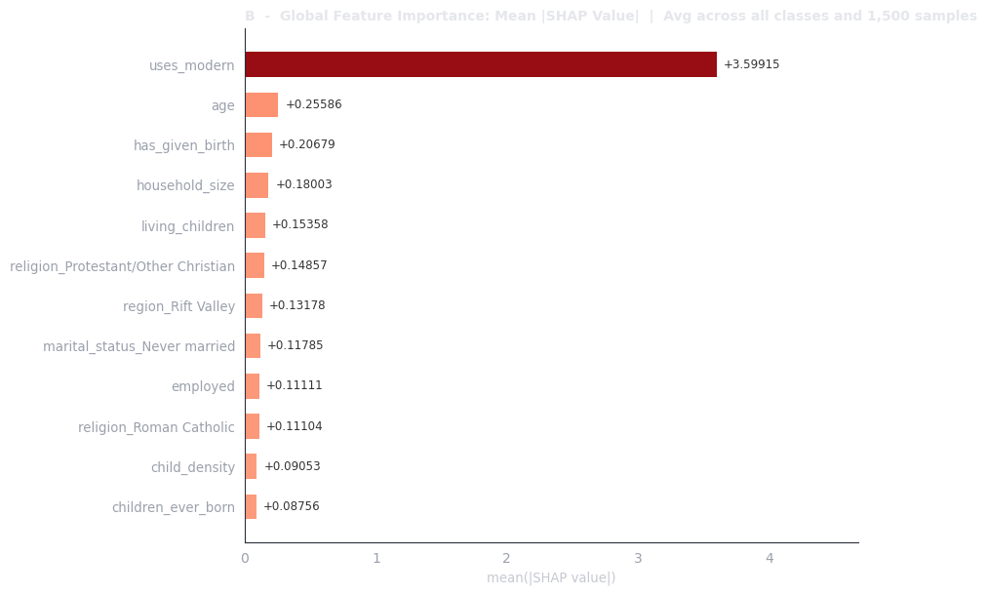
CAPSTONE PROJECT
SHAP Panel B: Global Feature Importance
Mean |SHAP| Value Per Feature
Averaged across all four classes and 1,500 test respondents.
Ranking
Age — by far the strongest overall (0.271)
Living children (0.224)
Employment status (0.155)
Arid county (0.096)
Region / county dummies
Age and living_children are universal discriminators across all four classes.
Moringa School Capstone • The Insight Architects • 22 / 28

Slide 23
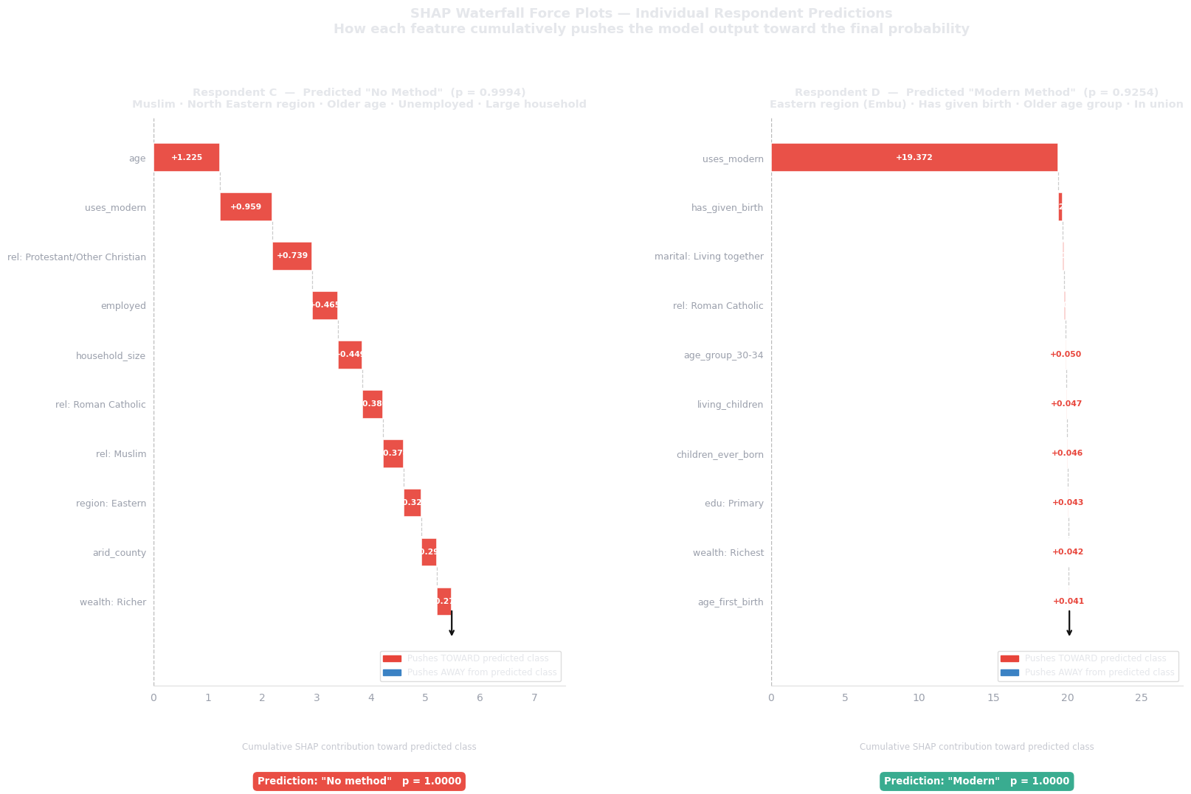
CAPSTONE PROJECT
SHAP Panels C & D: Two Real Women
Respondent C (“No method”, p=0.9994)
Young, never-married, zero children, no employment. Every feature pushes away from modern use.
Respondent D (“Modern”, p=1.0000)
Older, married, multiple children, employed. Age and living_children are the dominant positive drivers.
Why This Matters
Individual-level explanations build stakeholder trust and validate the model’s logic against domain knowledge.
Moringa School Capstone • The Insight Architects • 23 / 28

Slide 24
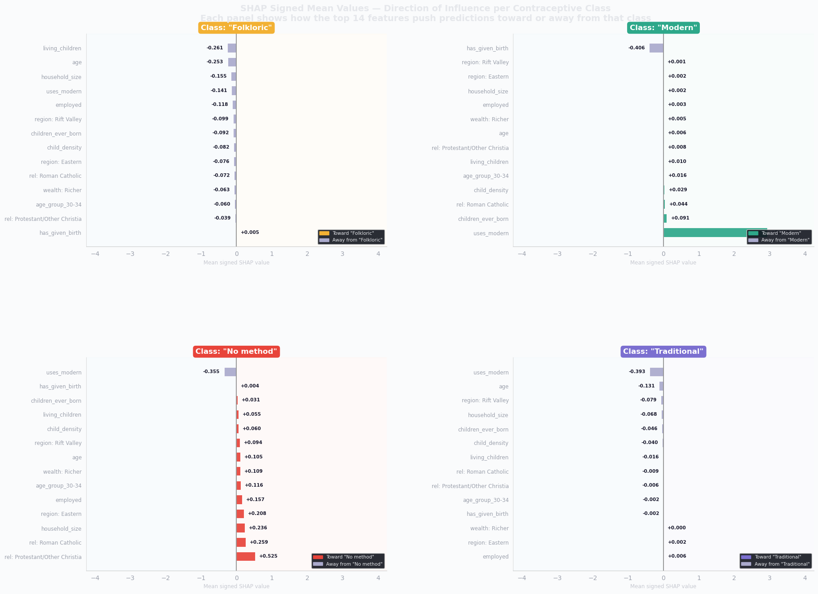
CAPSTONE PROJECT
SHAP: Per-Class Breakdown & Direction of Influence
Per-Class Breakdown
Age and living_children are tall bars for every class — universal discriminators.
Region/arid_county are disproportionately important for Traditional/Folkloric classes.
Direction Heatmap
is_in_union: deep red for Modern, blue for No-method — strongest enabler
arid_county: red for No-method, blue for Modern — infrastructure barrier
employed: enables Modern, penalizes No-method
Moringa School Capstone • The Insight Architects • 24 / 28

Slide 25
CAPSTONE PROJECT
Summary of Key Insights
From the Notebook (10 Key Findings)
1. Target is heavily imbalanced: 58.1% no method, 37.9% modern, 3.8% traditional, 0.2% folkloric.
2. County is the biggest signal: modern use 1% (Mandera) to 57% (Embu).
3. No education: ~12% modern use. Any education: 37–46%.
4. Wealth is a cliff: Poorest at 25%, flat at 41–43% above.
5. Residence barely matters: urban and rural both ~38%.
6. Education outweighs wealth across every wealth group.
7. children_ever_born and living_children: r=0.98, one dropped.
8. LightGBM selected: best accuracy 72.4%, best Macro-AUC 0.798.
9. RF has best Macro-F1 (0.390 vs 0.367) — tradeoff for minority classes.
10. SHAP: age strongest, then living children; is_in_union top enabler; arid_county structural barrier.
Moringa School Capstone • The Insight Architects • 25 / 28

Slide 26
Deployment & Recommendations
From model to actionable policy impact

Slide 27
CAPSTONE PROJECT
Deployment: Flask API on Render.com
Interactive Web Application
Deployed on Render.com for stakeholders (MoH, CHPs, UNFPA, USAID Kenya, FP2030).
Serve-Skew Prevention
feature_engineering.py is a shared module — identical transformations at training and serving.
Model Bundle
contraceptive_model_bundle.joblib (5.6 MB): model + preprocessor + label encoder.
API Endpoints
GET / HTML Form Interface GET /health Liveness Check POST /predict Single Prediction POST /predict_batch Batch Predictions
Live URL
kdhs-contraceptive-api.onrender.com
Auth: X-API-Key header required
Docker Support
docker build -t kdhs-api . docker run -p 5000:5000 kdhs-api
Moringa School Capstone • The Insight Architects • 27 / 28

Slide 28
CAPSTONE PROJECT
Actionable Policy Recommendations
1. Geographic Targeting (Highest Priority)
Mandera (1.2%), Wajir (2.8%), Garissa (4.5%), Marsabit (5.6%), Tana River (20.0%). SHAP weight 0.096 confirms the gap persists after controlling for wealth, education, religion. Fund mobile clinics.
2. Target Exposed Non-Users, Not All Non-Users
4-variable CHP filter: in union + not employed + Poorest + arid county. Young never-married childless women are non-exposed, not underserved.
3. Employment-Linked Programming
employed is the highest-ranked policy-tractable driver. Co-locate FP info with women’s economic empowerment programmes.
4. Subsidize the Poorest Quintile
24.9% → 40.8% at Poorer; then only 1.8pp gain above. Target subsidies at Poorest exclusively.
5. Model Limitations (Honest)
Folkloric (53 cases) and Traditional cannot be predicted reliably. Use as binary Modern/Non-use risk flag, not 4-class predictor.
Moringa School Capstone • The Insight Architects • 28 / 28

Slide 29
Thank You!
Questions & Answers
GitHub:
github.com/symekah1999/Predicting-contraceptive-use-among-women
Live App:
kdhs-contraceptive-api.onrender.com
Moringa School Capstone • The Insight Architects • 29 / 28

